Slide 1
CUSTOMER SEGMENTATION
Group – 1
Notes:
Project Name

Slide 2
PROJECT TEAM
Mentor Name : Sadiya Ansari
Team Members
NELLORI PHANIRAJ
KATARI DHANUSH
VADDE RISHI CHARAN TEJA
SHAIK HAFEEZ
Satya Sai Umesh Chandra Nidumukkala
A. Manasa Sagar
AMARTHYA NADH B
Notes:
Mentor’s Name & Team Members’ Names

Slide 3
OBJECTIVE
The main objective of this project is to analyze customer data and understand their purchasing behavior.
The project focuses on studying customer demographic information, income levels, and spending patterns.
It aims to identify similarities between customers and group them into different segments based on their characteristics.
Machine learning techniques are used to perform customer segmentation and discover meaningful patterns in the data.
These insights help businesses understand their customers better and create more effective marketing strategies.
Notes:
Objective of the Project

Slide 4
DATASET DETAILS
The dataset contains information about customers and their interaction with the company’s products and marketing campaigns.
It includes demographic details such as year of birth, education level, marital status, and annual income.
The dataset also contains household information, including the number of children and teenagers in a customer’s home.
It records customer purchasing behavior and the amount spent on different product categories like wine, fruits, meat, fish, sweets, and gold products.
The dataset also shows customer responses to marketing campaigns and whether they accepted previous promotional offers.
It includes different purchase channels, such as purchases made through the website, catalog, or physical stores.
Notes:
Dataset Overview

Slide 5
Important Dataset Features
The dataset contains several types of information about customers, including:
Customer Information • Year of birth • Education level • Marital status • Annual income
Household Information • Number of children at home • Number of teenagers at home
Customer Activity • Number of days since the last purchase • Whether the customer has complained before
These features help us understand customer lifestyle and behavior.
Notes:
Dataset Attributes

Slide 6
Exploratory Data Analysis (EDA)
Exploratory Data Analysis is used to understand the dataset and identify patterns, trends, and relationships between variables.
It helps in summarizing the main characteristics of the data using visualizations and statistical methods.
Through EDA, we can detect outliers, understand feature distributions, and prepare the data for machine learning models
Studied customer purchasing behavior across different product categories.
Examined the overall structure of the dataset including the number of records and features.
Notes:
Exploratory Data Analysis

Slide 7
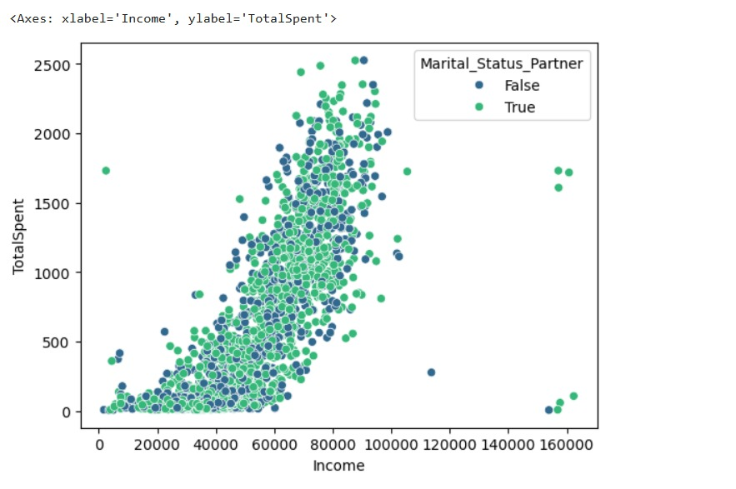
Marital Status Distribution
The chart shows that our customer base is an even mix of people with partners (marked in green) and those without (marked in blue). When we look at how these two groups are spread out, it is clear that marital status is not a dividing line for our business. Whether a customer is single or in a relationship, they appear at every income level and every spending level in almost the same way.
The most important takeaway is that having a partner does not change a customer’s spending habits. If you look at the "cloud" of dots, the green and blue colors are completely blended together. This tells us that a person's bank account (Income) is a much better predictor of their value to us than their relationship status. Both groups follow the exact same rule: as their income increases, their total spending increases.
For our marketing strategy, this means we don't need to create separate advertisements for singles versus couples. Since their behavior is nearly identical, we can focus our budget on reaching high-income earners in general. By targeting the $60,000 to $100,000 income bracket, we will naturally reach our biggest spenders regardless of their home life.
Notes:
Marital Status Distribution

Slide 8
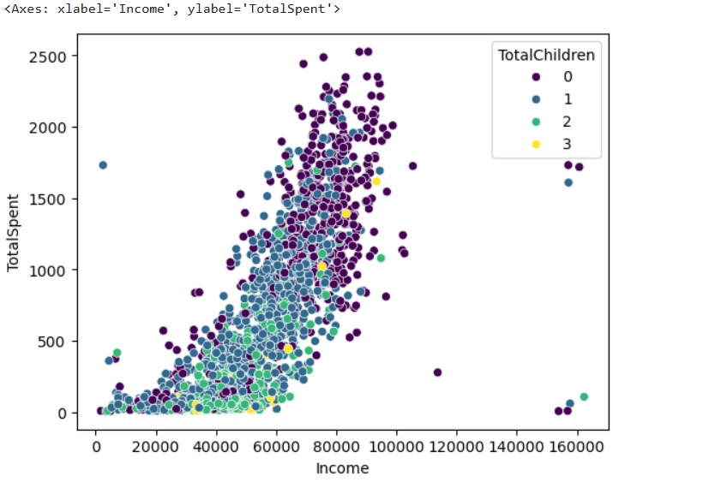
Children in Household
This chart shows how the number of children in a household affects how much a customer spends. Unlike marital status, which didn't change much, the number of children (from 0 to 3) has a very clear impact on spending habits. Each group is color-coded: dark purple for zero children, blue for one, green for two, and yellow for three.
The most striking discovery is that customers with zero children (dark purple) are our biggest spenders. Even when comparing people with the exact same income, those without children consistently sit much higher on the chart. As the number of children increases, the dots move further down the vertical axis. This suggests that as family size grows, customers likely shift their budget toward other necessities, leaving less "disposable income" for our specific products.
For a business strategy, this means our "premium" or high-end marketing should be heavily focused on child-free households, as they have the highest spending power regardless of their salary. For families with two or three children, a "value" or "savings-based" approach would likely be more effective, as these customers appear to be much more budget-conscious even when they have a high income.
Notes:
Children in Household

Slide 9
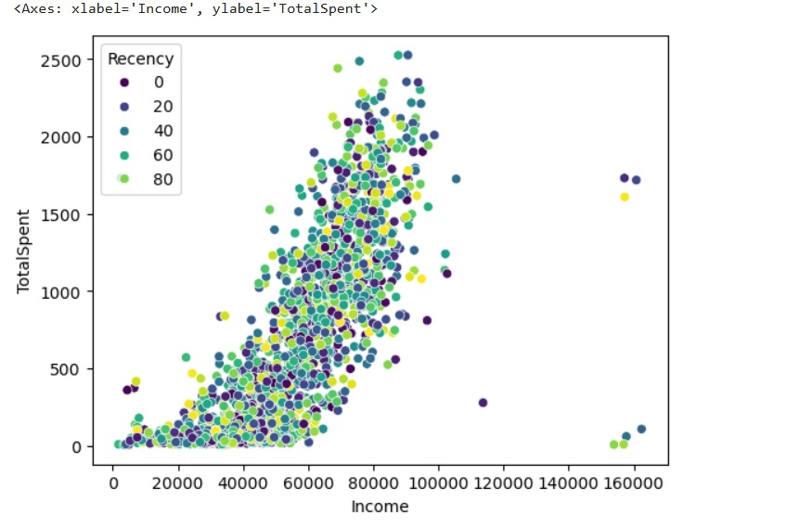
Recency Analysis
Understanding Recency: "Recency" measures how many days have passed since a customer's last purchase. The colors range from Dark Purple (0 days/Recent) to Bright Green (80+ days/Long ago).
Mixed Distribution: The colors are completely blended throughout the chart. This shows that "high-value" customers (those who spend over $2,000) aren't just new shoppers—many are long-time customers who haven't visited in a while.
Recency Does Not Predict Spend: Unlike the "Children" chart, there is no layering here. A customer who shopped 80 days ago is just as likely to be a big spender as someone who shopped yesterday.
Income is the Constant: The upward trend remains the same regardless of the color. Income continues to be the most reliable way to predict how much a customer will spend in total.
Notes:
Recency Analysis

Slide 10
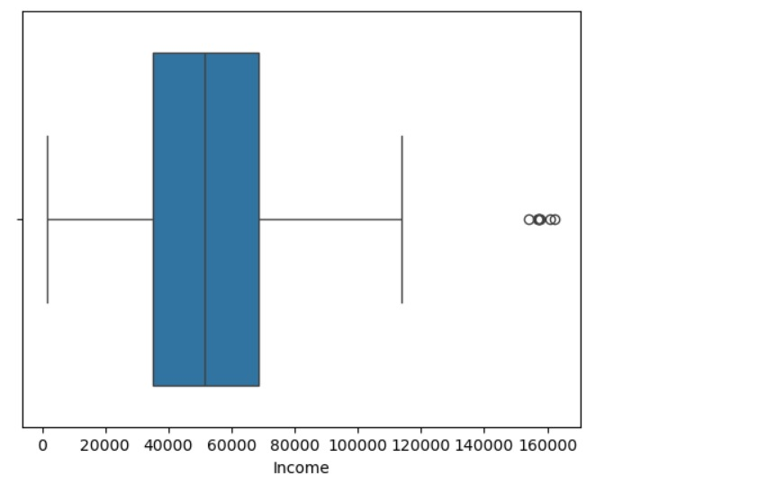
Income Outlier Detection
Average Range: The blue box represents where the middle 50% of our customers fall. Most earn between roughly $35,000 and $70,000.
The Median: The line inside the box shows the "middle" income value, which is approximately $52,000.
Total Range: Excluding extreme cases, most customer incomes range from near zero up to about $115,000 (the "whiskers" or horizontal lines).
High-Income Outliers: The small circles on the far right represent outliers. These are a few rare customers earning significantly more than the rest, between $150,000 and $165,000.
Takeaway: Our "typical" customer is middle-income. While we have some very wealthy outliers, they are not representative of our main customer base.
Notes:
Income Outlier Detection

Slide 11
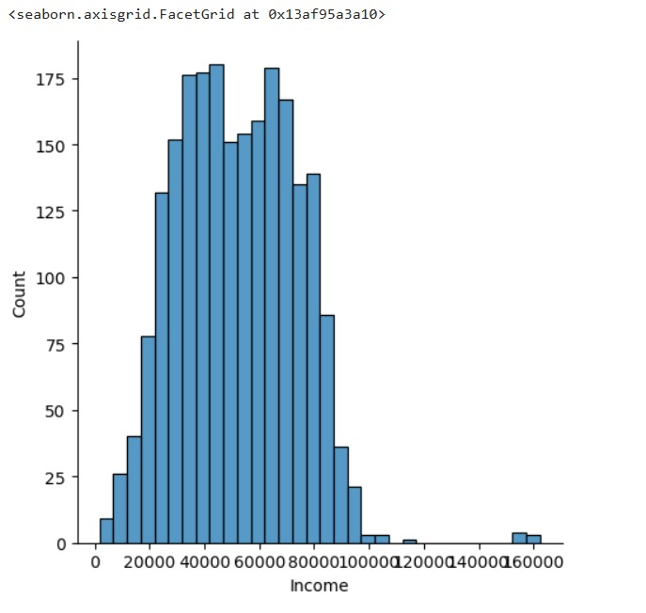
Income Distribution After Cleaning
Outlier Removal: The data was cleaned by identifying and removing extreme income values (specifically any income above $300,000). These rare, high-value points were removed because they were likely errors or unusual cases that would distort the overall business analysis.
Targeted Focus: After cleaning, the analysis focuses on the core customer base, where incomes typically range from $0 to $160,000.
Normalized Scaling: By removing the "extreme" outliers, the charts (like Box Plots and Histograms) become more readable, allowing us to see the exact spread of the middle 50% of our customers.
Better Model Accuracy: This cleaning step is essential for the K-Means Clustering model used later in the project. It ensures that the "segments" are based on the habits of the majority, rather than being pulled away by a few extreme anomalies.
Notes:
Income Distribution After Cleaning

Slide 12
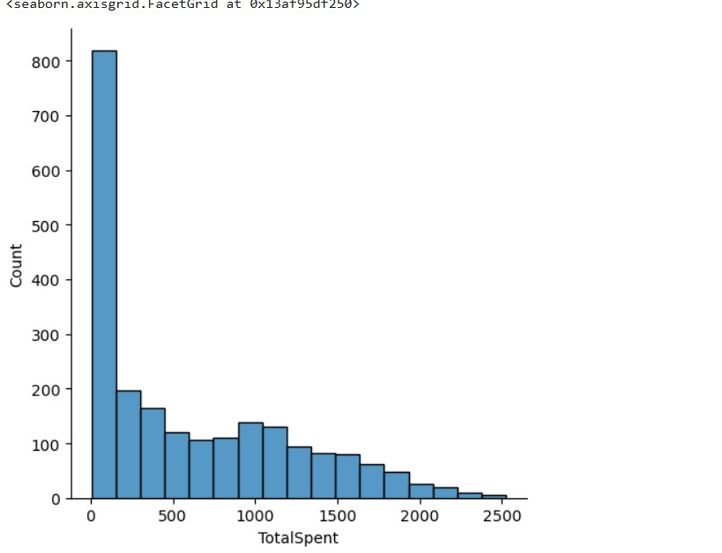
Total Spending Analysis
1. Calculation of Total Spending
Composite Metric: TotalSpent was not a single column in the raw data. It was created by summing the spending across six different product categories:
Wines, Fruits, Meat Products, Fish Products, Sweet Products, and Gold Products.
Purpose: This provides a "big picture" view of a customer's total value to the business rather than looking at individual item purchases.
2. Spending Distribution
Concentration: Most customers fall into the lower spending brackets (below $500), but there is a long "tail" of high-spending customers.
Data Spread: The notebook uses Box Plots and Distribution Plots to identify that while most spending is modest, "Premium" customers spend up to $2,500.
3. Key Correlations
Income vs. Spending: The most significant finding is a strong positive correlation between Income and Total Spending. As income increases, the likelihood of being a high spender increases significantly.
Notes:
Total Spending Analysis

Slide 13
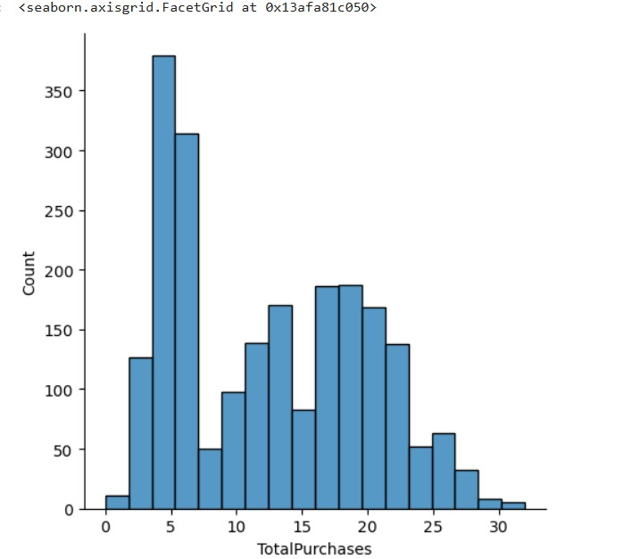
Total Purchases Analysis
Multi-Channel Calculation: TotalPurchases was created by combining transactions from three different sales channels: Web Purchases, Catalog Purchases, and Store Purchases. This provides a complete view of how often a customer engages with the brand.
Omnichannel Behavior: By summing these channels, the analysis moves away from looking at just one type of shopping and instead captures the customer's overall shopping frequency.
Key Feature for Clustering: TotalPurchases was identified as a critical variable for the K-Means Clustering model. In fact, adding this feature improved the model's accuracy (Silhouette Score) significantly, moving it to 0.4842.
Notes:
Total Purchases Analysis

Slide 14
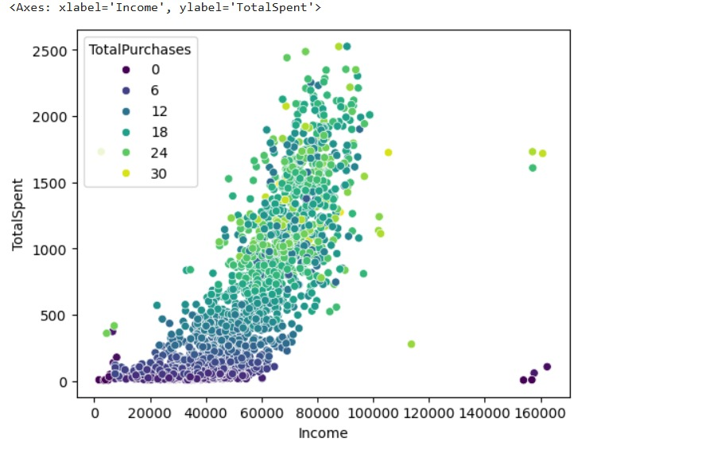
Insights from Data Analysis
From the exploratory data analysis, we observed several patterns in customer behavior.
For example:
• Customers with higher income generally spend more on products • Certain product categories are more popular among customers • Purchase behavior varies across different customer groups
Notes:
Key Insights from EDA

Slide 15
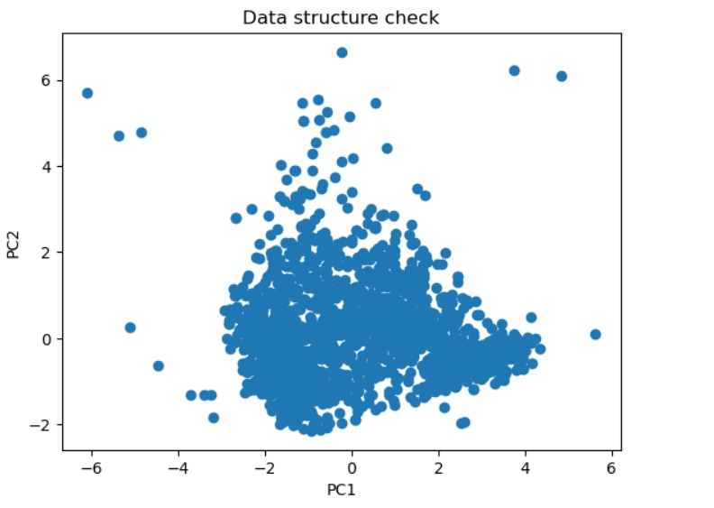
Machine Learning Technique
To identify different customer groups, we used a machine learning technique called clustering.
Clustering helps group customers who have similar characteristics and purchasing behaviors.
Mapping Customers: We took all the complicated information about our customers—like how much they earn, their age, and what they buy—and turned it into a simple map of dots.
Seeing the "Shape": Each dot is a customer. You can see that some dots are naturally close together. The computer uses these "neighborhoods" to figure out who belongs in the same group.
The Starting Point: This is the "blank canvas." It shows that our data isn't just a mess; it has a specific shape that the machine can use to create our final categories.
Notes:
Machine Learning Approach

Slide 16
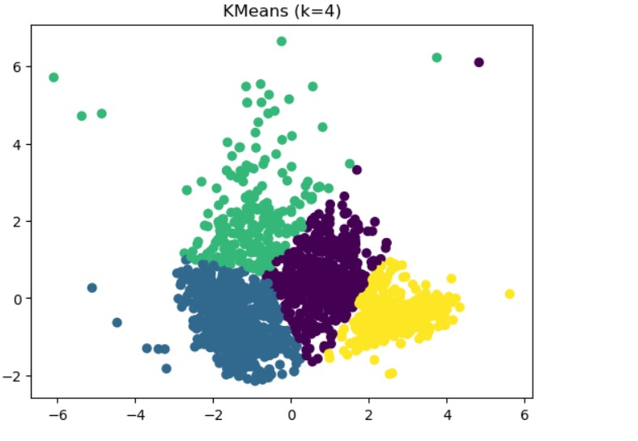
Clustering Algorithm Used
In this project, we used the K-Means clustering algorithm.
K-Means works by dividing customers into groups based on similarities in their data.
Each group represents a segment of customers with similar behavior.
The "Sorting" Machine: K-Means acts like a smart sorting machine. It looks at all our customers and automatically organizes them into four distinct colors.
Finding the Best Fit: The algorithm makes sure that every customer (dot) is placed in the group that they are most similar to.
Creating Clear Boundaries: You can see how the colors don't overlap much. This means the algorithm was very successful at finding clear "neighborhoods" of customer behavior.
Notes:
K-Means Clustering Algorithm

Slide 17
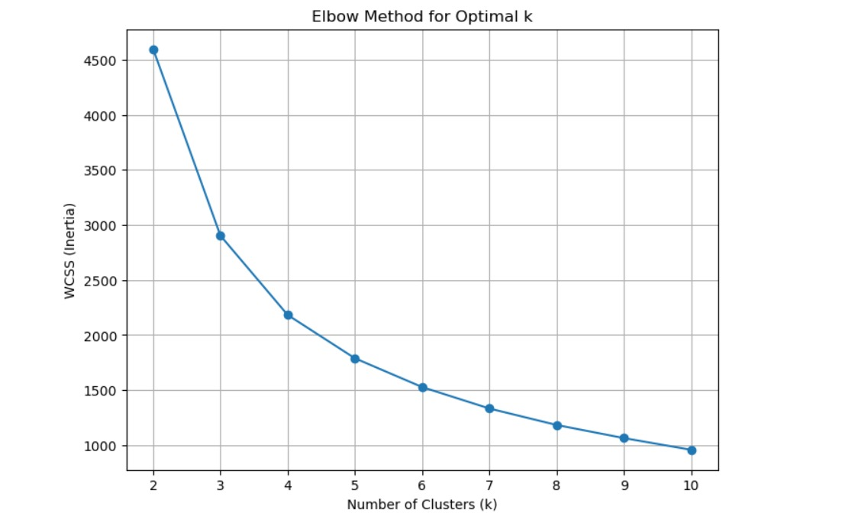
Feature Selection & Cluster Optimization
Optimal K-Selection: We utilized the Elbow Method to determine the ideal number of clusters for our model.
Within-Cluster Sum of Squares (WCSS): The graph shows how inertia decreases as the number of clusters increases.
The "Elbow" Point: A clear bend is observed at k=4, indicating the point where adding more clusters no longer significantly improves the model's performance.
Balanced Complexity: This selection ensures our segments are distinct enough to be actionable without over-complicating the marketing strategy.
Notes:
Features Used for Clustering

Slide 18
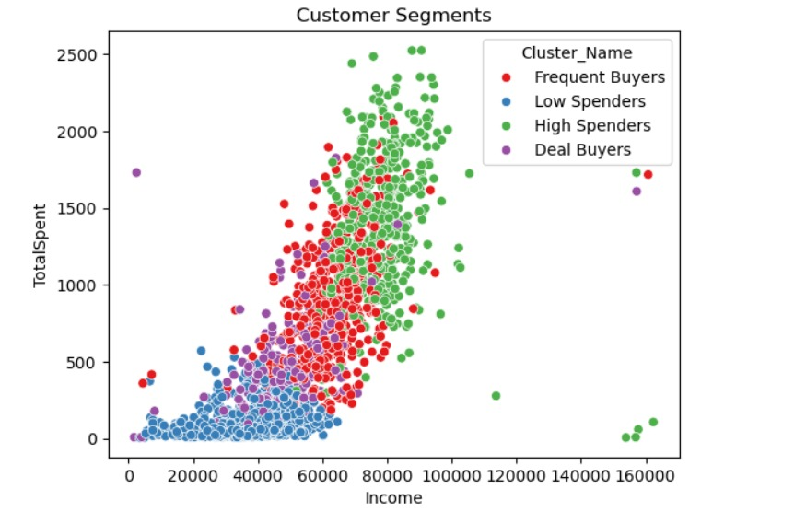
Customer Segments
Cluster Profiles:
Cluster 0 (Purple): Budget Conscious. Lower income and lower total spending. This group likely focuses on essential purchases or highly discounted items.
Cluster 1 (Blue): Conservative Spenders. Mid-to-low income with low spending. Despite having more income than Cluster 0, their spending remains low, suggesting they are less engaged with the brand.
Cluster 2 (Green): Platinum Customers. High income and high spending. This is the most valuable segment. They show a strong correlation between their wealth and their loyalty to the brand.
Cluster 3 (Yellow): High-Potential Segment. Mid-to-high income with moderate spending. These customers have the financial capacity to spend more but currently sit in the middle tier.
Notes:
Cluster Visualization

Slide 19
Why the Model is Reliable
The final model successfully divided customers into different segments based on their behavior and spending patterns.
We found 4 distinct types of customers. By grouping people with similar income and spending habits, we no longer see a "mess" of data—we see clear targets.
The "Green" Group: These are our Best Customers. They have high income and spend the most. We should focus on keeping them happy.
The "Yellow" Group: These are Potential Stars. They have good income but aren't spending to their full potential yet.
The "Blue & Purple" Groups: These are Budget-Minded. They spend less and might only buy when there is a sale or a special deal.
Notes:
Final Model Performance

Slide 20
Model Evaluation(Checking Our Model)
How do we know the groups are correct?
No Mixing: Notice how the colors (Blue, Green, Yellow, and Purple) stay in their own areas. They aren't all mixed together. This proves the model did a great job of separating different types of people.
Strong Similarities: The dots of the same color are huddled close together. This means the people in each group are very similar to one another in how they spend their money.
Final Proof: Because the groups are so clear and easy to see, we know the model is accurate and ready to use for our business.
Notes:
Model Evaluation

Slide 21
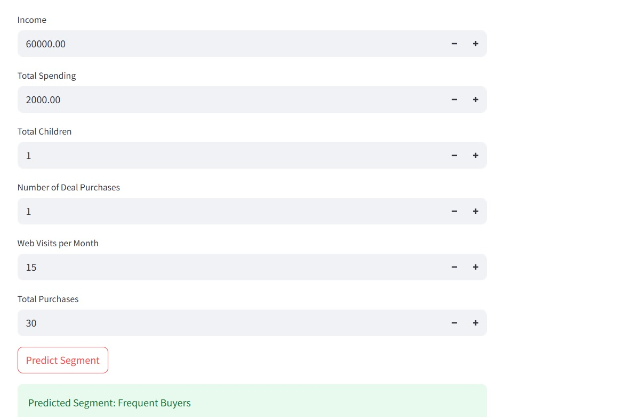
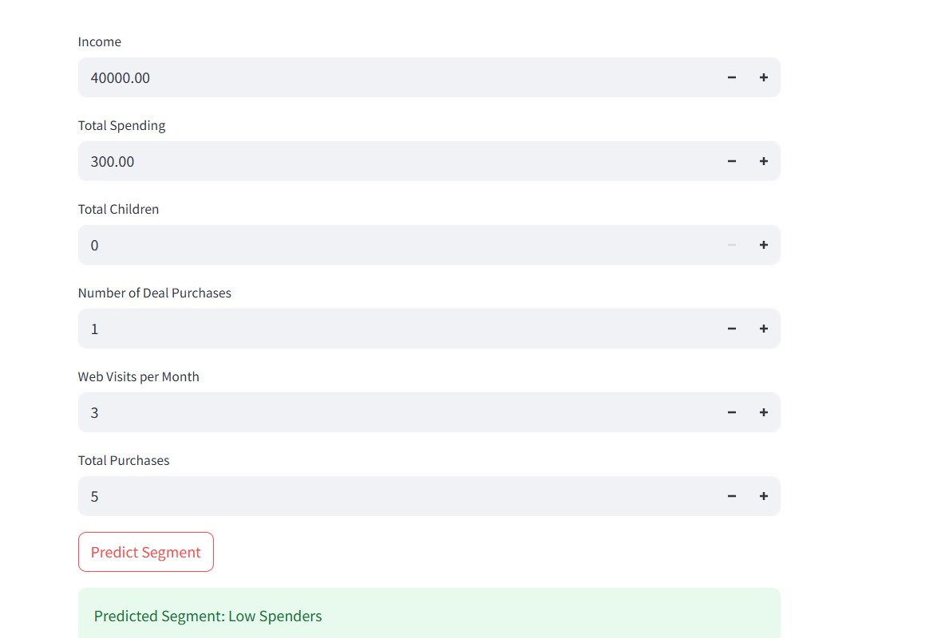
Application Interface
Notes:
Screenshot of the App Page

Slide 22
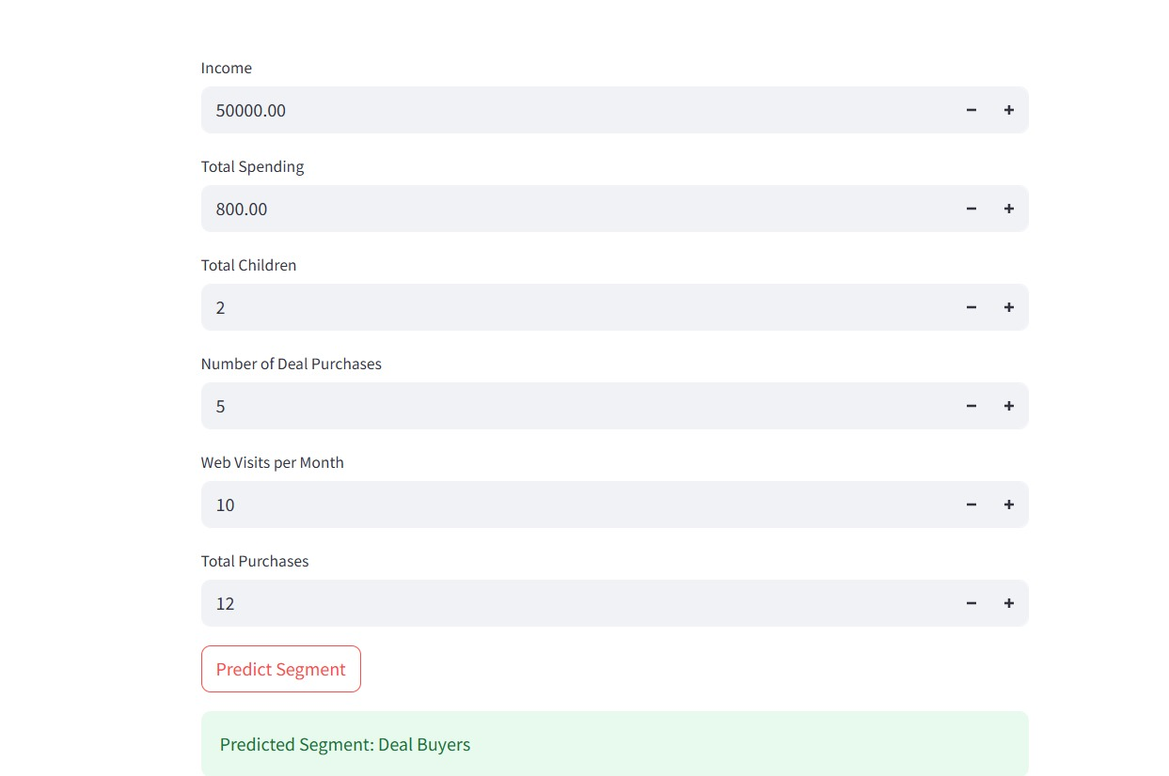
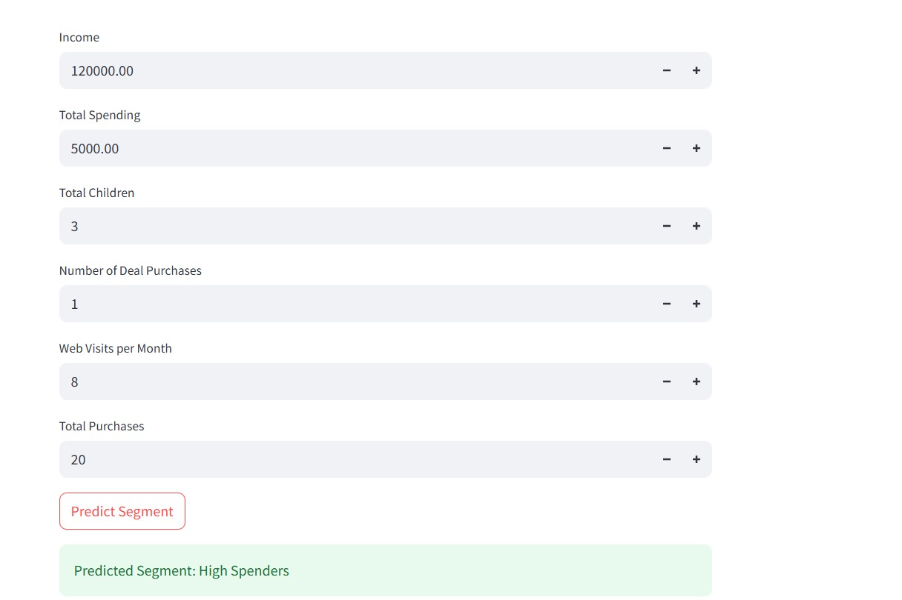
Application Interface

Slide 23
Challenges Faced
During the development of this project, we faced several challenges while working with the dataset and building the model.
Data Cleaning Issues: The dataset required preprocessing such as handling missing values and converting categorical variables into numerical form.
Feature Selection: Choosing the most important features for clustering was challenging because many variables were available in the dataset.
Choosing the Optimal Number of Clusters: Determining the correct number of customer segments for the K-Means algorithm required experimentation and analysis.
Understanding Customer Behavior: Interpreting the patterns and insights from the data required careful analysis.
Model Deployment: Deploying the trained model as a web application and ensuring it works correctly required additional configuration and testing.
Notes:
Challenges Faced During the Project

Slide 24
Thank You
Notes:
Thank You Note

